Slide 1

Today’s Agenda
Analysis of sequential circuits
Finite State Machine

Slide 2
Finite State Machine (FSM)
FSM:
  Generalized models of a sequential circuit
  How the elements can be connected
    Next state combinational logic
    Memory (F/F, Registers)
    Output combinational logic
Two Common Types FSM
  Mealy Machine: O/P is function of present state and input.
  Moore Machine: O/P is function of only present state.
Examples (already seen)

Slide 3
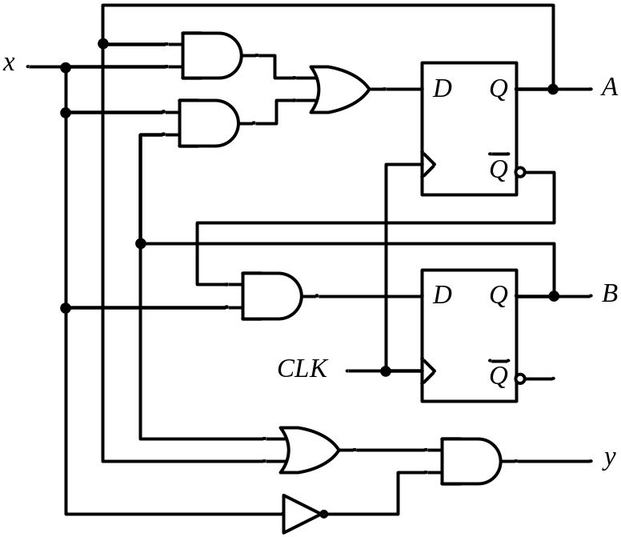
State Table (Previous Lec)
Example
Present State |  | Input | Next State |  | Output
A | B | x | A | B | y
0 | 0 | 0
0 | 0 | 1
0 | 1 | 0
0 | 1 | 1
1 | 0 | 0
1 | 0 | 1
1 | 1 | 0
1 | 1 | 1
0 0 0
0 1 0
0 0 1
1 1 0
0 0 1
1 0 0
0 0 1
1 0 0
A(t+1) = A x + B x
B(t+1) = A’ x
y(t) = (A + B) x’
For the same state,
the output changes with the input
O/p depends on: both the present states and the I/p

Slide 4
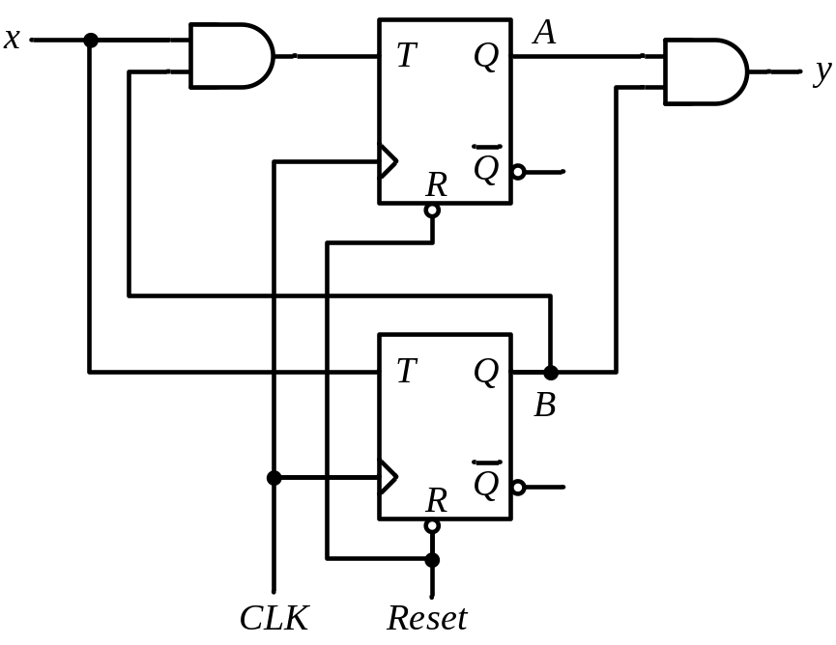
Analysis of CLK Seq. Ccts (T-F/F)
Present State |  | I/P | Next State |  | F.F Inputs |  | O/P
A | B | x | A | B | T_{A} | T_{B} | y
0 | 0 | 0
0 | 0 | 1
0 | 1 | 0
0 | 1 | 1
1 | 0 | 0
1 | 0 | 1
1 | 1 | 0
1 | 1 | 1
0 0
0 1
0 1
1 0
1 0
1 1
1 1
0 0
0 0
0 1
0 0
1 1
0 0
0 1
0 0
1 1
0
0
0
0
0
0
1
1
T_{A} = B x T_{B} = x
y = A B
A(t+1) = T_{A} Q’_{A} + T’_{A} Q_{A}
= AB’ + Ax’ + A’Bx
B(t+1) = T_{B} Q’_{B} + T’_{B} Q_{B}
= x ⊕ B
For the same state,
the output does not change with the input
O/p depends only on the present states

Slide 5
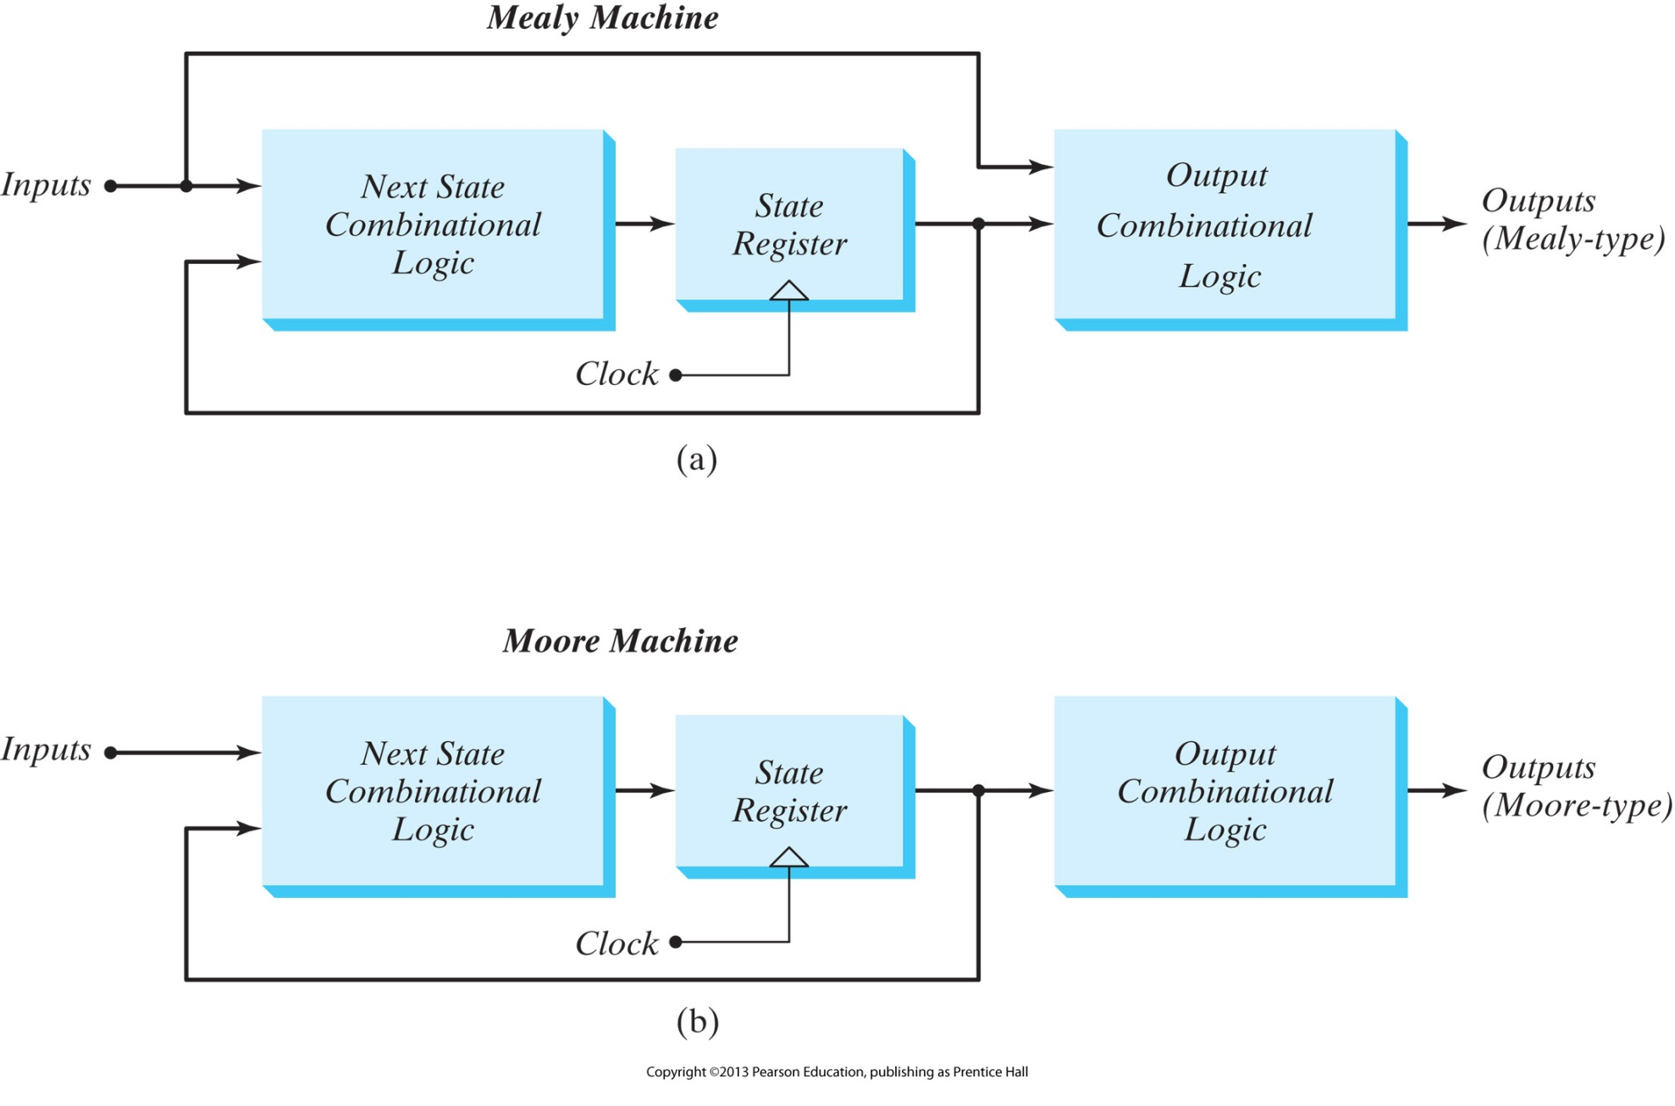
FSM Model for Mealy Machine
The output is a function of both the present state and the input
The output changes asynchronous to the clock.
Difficult to do timing analysis.

Slide 6
FSM Model for Moore Machine
The output is a function of only the present state
The output changes synchronous to the clock
Easier Timing Analysis

Slide 7
Moore State Diagram
(Another Representation)
State / Output
0
0
1
0 0 / 0
0 1 / 0
1
1
1 1 / 1
1 0 / 0
0/0
1
0/0
0
0
0 0
1/0
0 1
O/p is not depending on I/p.
It is only dependent upon present states
1/1
1/0
1 1
1 0
0/0
0/1
1/0

Slide 8
State Reduction:
Analysis:
  Circuit diagram → State Table / State Diagram
Design (Synthesis):
  State Table / State Diagram → Circuit diagram
Redundant/ equivalent State:
  Redundant state may exist in state table or diagram.
  By eliminating the redundant state, we can reduce number of logic gates and flip flops.

Slide 9
Practice Problems
5.1,5.2, 5.4 (a,b,d),5.6,5.7,5.8,5.9,5.10

